Slide 1

BASIC DETAILS OF TEAM & PROBLEM STATEMENT
Ministry:
Government of Rajasthan
P.S. Code:
TK1050
Problem Statement Title:
To create systems that alleviate waiting in line - at doctors, at shops, at bus stops.
Team Name:
“Optimizers”
Team Leader Name:
Md Kashif Raza
Institute Name:
Institute of Engineering and Technology, Devi Ahilya Vishwavidyalaya
Institute AISHE Code:
Theme/ Domain Bucket:
Miscellaneous

Slide 2
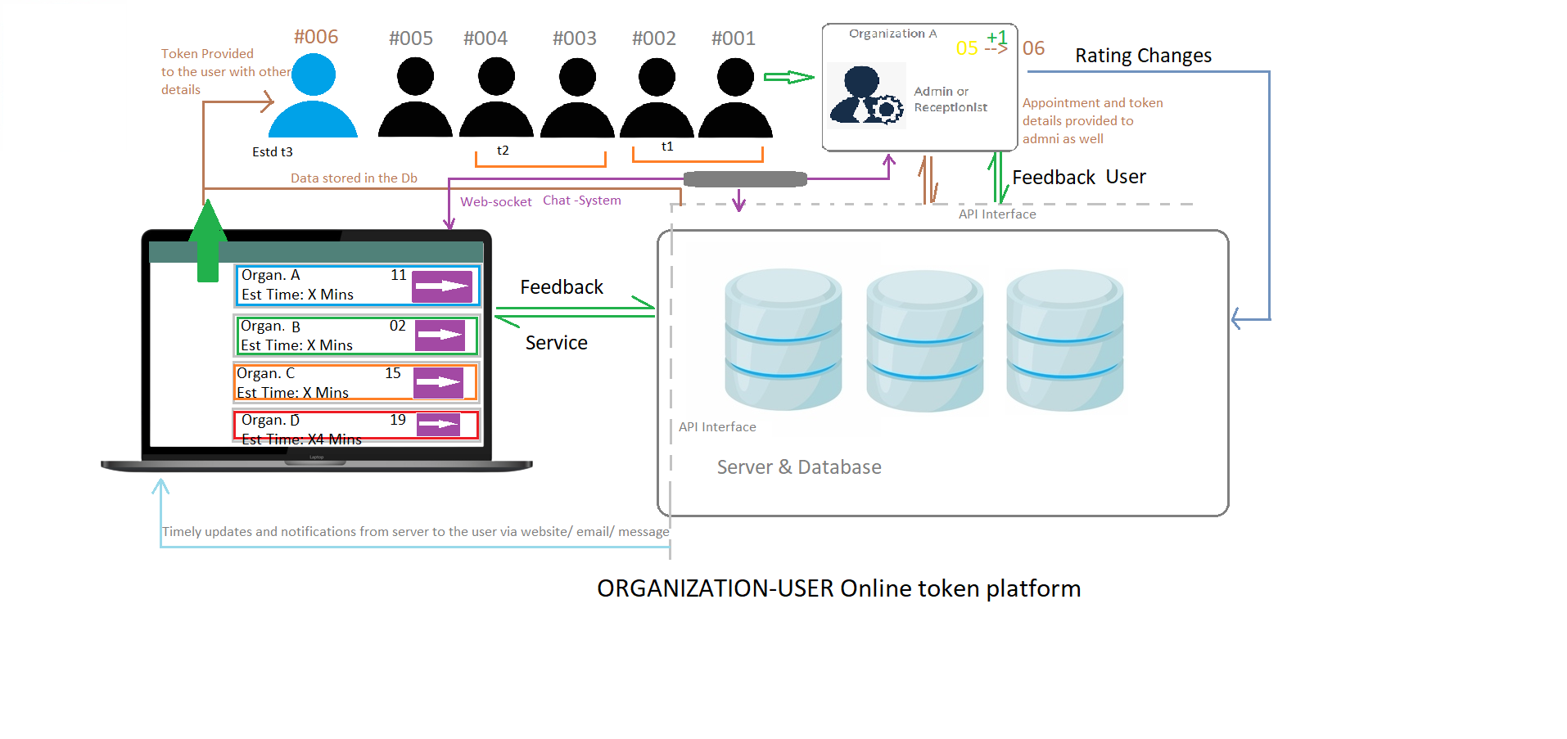
Idea/ Approach Details:
Working-flow chart & prototype image
Solution & protype description:
User are able to view the facility centres using Web-Application according to their location and requirement (e.g. Medical Store/ Clinic / Shops/ Bus Stops etc.)
Sort the shown facilities as per the availability and rating shown in the website, by fetching data in real-time using an API.
An online token-based service will be provided to them to manage the queue and appointment details with the respective organization with token limits that can be governed either by closing-time or the number of appointments.
They will be provided with regular updates, estimated time of their appointment, options to cancel or reschedule the appointment whose details will be shared with the facility-administrators.
User can message directly to the organization admin via integrated chat system.
After the completion of session, users will be provided with feedback form via website/ email/message that the service provided was good or not?
If somehow the user, missed his/her token then he/she will be given an option to reschedule it later.
If user has registered, then he/she can see the history and logs for his or her previous appointments.
Technology Stack:
Backend-API: Node JS, Express, MongoDB, Mocha and Chai Testing Framework, Postman.
Web-backend: Node JS, Socket.io
Web-frontend: HTML, CSS and JavaScript and Bootstrap.
Deployment: Heroku, Github

Slide 3
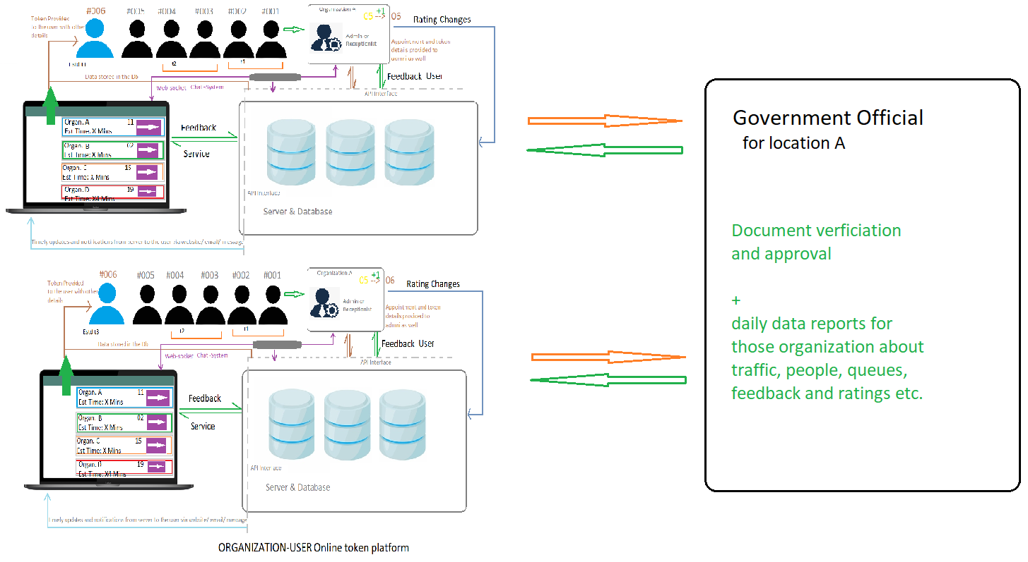
Idea / Approach details
Use Cases of Solution
This system cannot only work for particular organization like hospitals etc, but can also work for any institute where there is need for queues.
Important information like for hospitals (Beds) will also be displayed in the application front-end
Online-fee payment is also be there is some institute requires amount to get token/ appointment.
Novel Points of our Application / Dependencies
1-click token for appointment with any registered organization.
Feature to get token even before the start time of any organization if organization has permitted for early bookings.
Ratings of organization according to previous given feedbacks of users.
Feature to provide best alternatives of an organization based on the number of appointments, location and ratings.
All organization’s registration will be governed by state officials from gathering their details to verification of the documents to provide safety and protect consumer rights.
Feature to switch tokens from a known user due to any circumstances by providing the token id and personal details of that person (authorization required by the other user).

Slide 4
Team Member Details
Team Leader Name: Md Kashif Raza
Branch: B.E. Stream: Electronics & Telecommunications Year: III (3rd)
Team Member Name: Sakshi Magre
Branch: B.E. Stream: Electronics & Telecommunications Year: III (3rd)
Team Member Name: Muskaan Agrawal
Branch: B.E. Stream: Electronics & Telecommunications Year: III (3rd)
Team Member Name: Milisha Gupta
Branch: B.E. Stream: Electronics & Telecommunications Year: III (3rd)
Team Member Name: Kuldeep Gaur
Branch: B.E. Stream: Electronics & Telecommunications Year: III (3rd)
Team Member Name: Chirag Rawat
Branch: B.E. Stream: Electronics & Telecommunications Year: III (3rd)
Team Mentor Details
Team Mentor 1 Name: Mr/Mrs XYZ
Category: Academics Expertise: Domain Experience: XY Years
Team Mentor 2 Name: Mr/Mrs XYZ
Category: Industry Expertise: Domain Experience: XY Years

